Slide 1
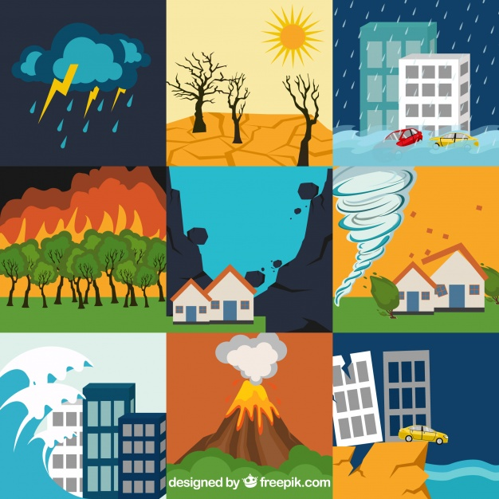
Lesson plan: Natural Disasters
Art 305
Group project
By: Sarah B, Heidi F, Bryan K, and Jasmine P.

Slide 2
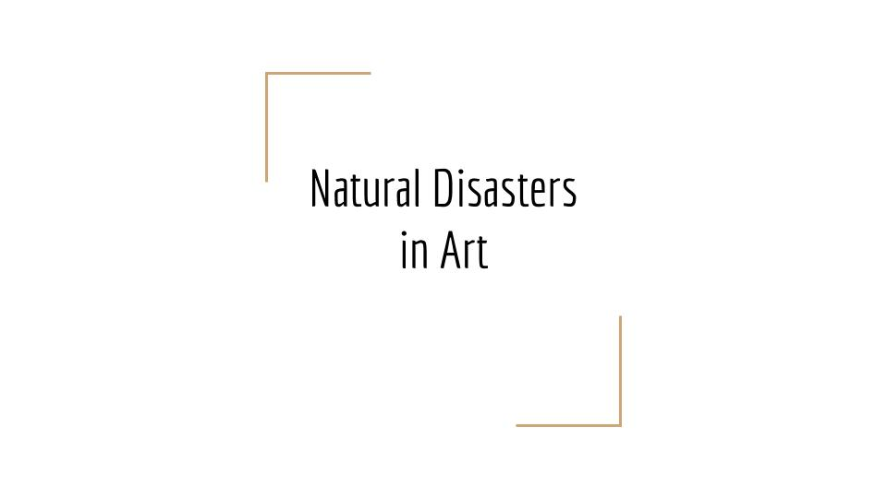
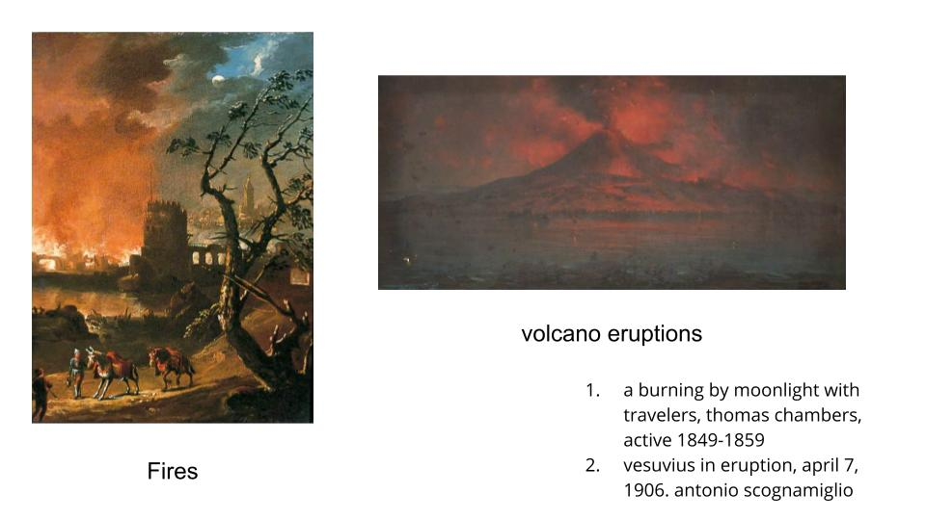
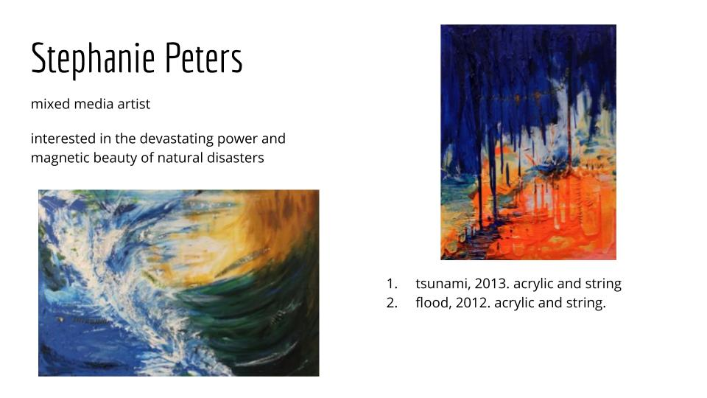
History Presentation

Slide 3
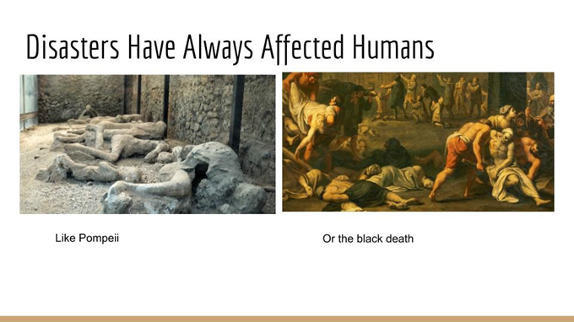
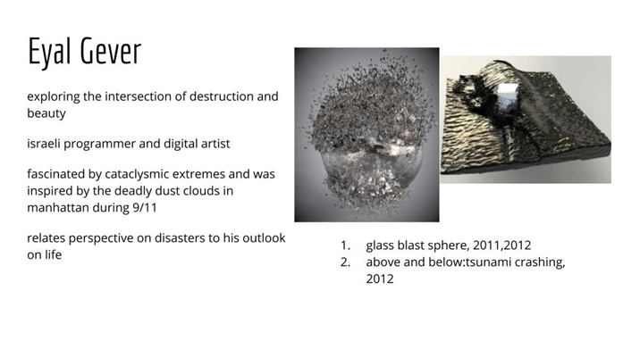
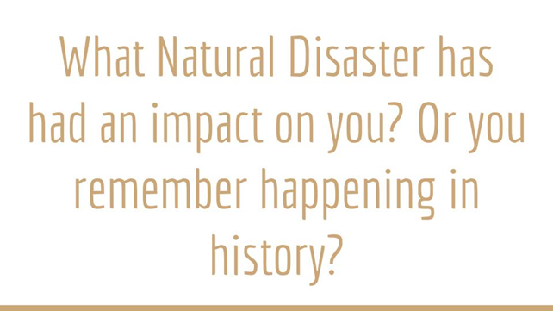

Slide 4

“Disaster Alert” Application Guide
Application
Download Disaster Alert App.
Look over the disasters happening around the world, learn about some of them.
Have a specific disaster type in mind?
  Use the search bar to find what are happening in the world right now.
Disaster types you can search are:
  Flood
  Volcano
  Typhoon
  Earthquake
  Wildfire
  Drought
  Storm
  Biomedical
  High Winds
Research about your chosen natural disaster by clicking on it and learn more with the attachment.
Take inspiration and create your project around this natural disaster.

Slide 5
Grading Rubric
Students will be able to use Disaster Alert to find a current Natural disaster. Using the information presented on the app, the student will then be able to create an artistic piece in one of the given medias to create an understanding and awareness of the event.

Slide 6
Anticipatory Set
https://quizlet.com/436406806/natural-disasters-page-flash-cards/

Slide 7
Lesson Plan

Slide 11
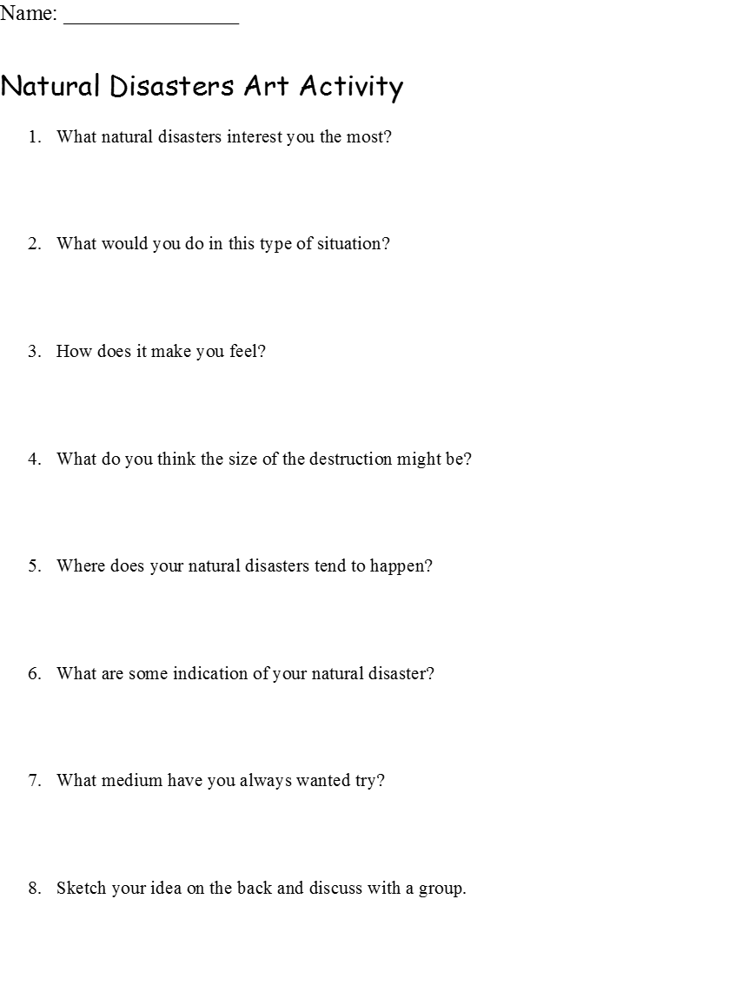
Transitional Activity

Slide 12
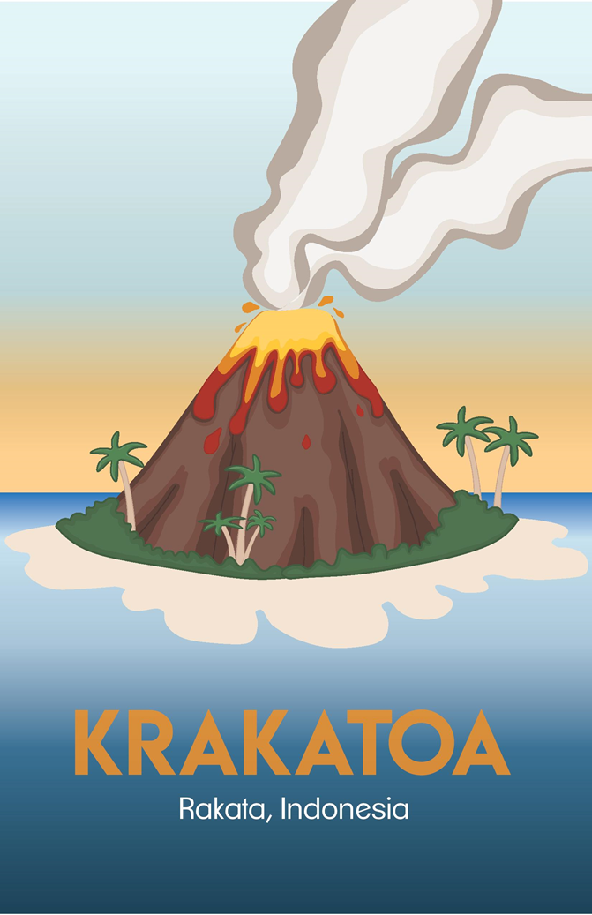
Art Project Results
Adobe Illustrator
By : Jasmine Pirkle

Slide 13
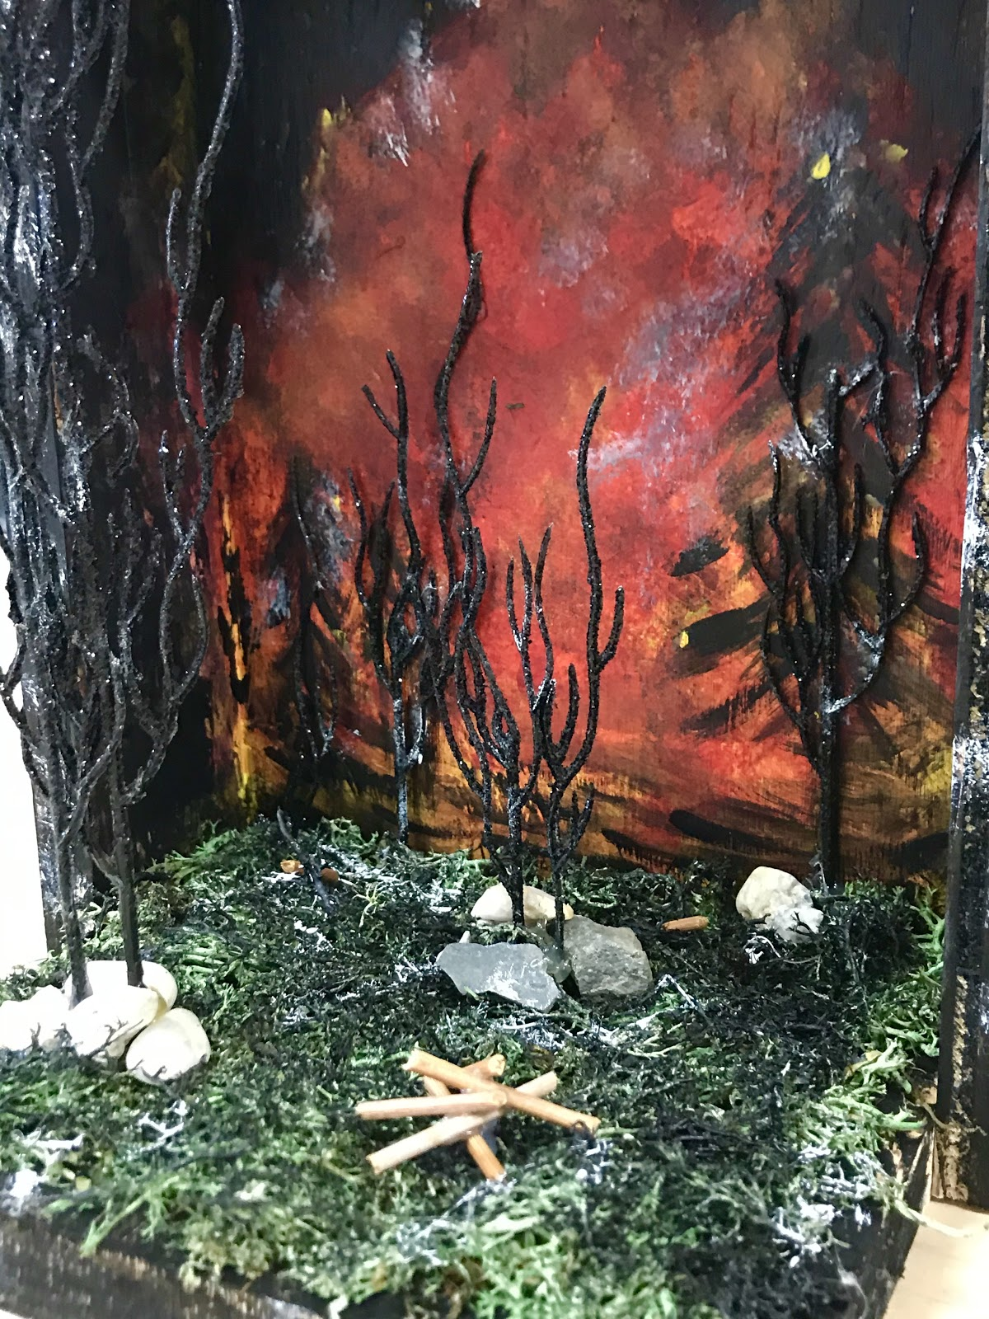
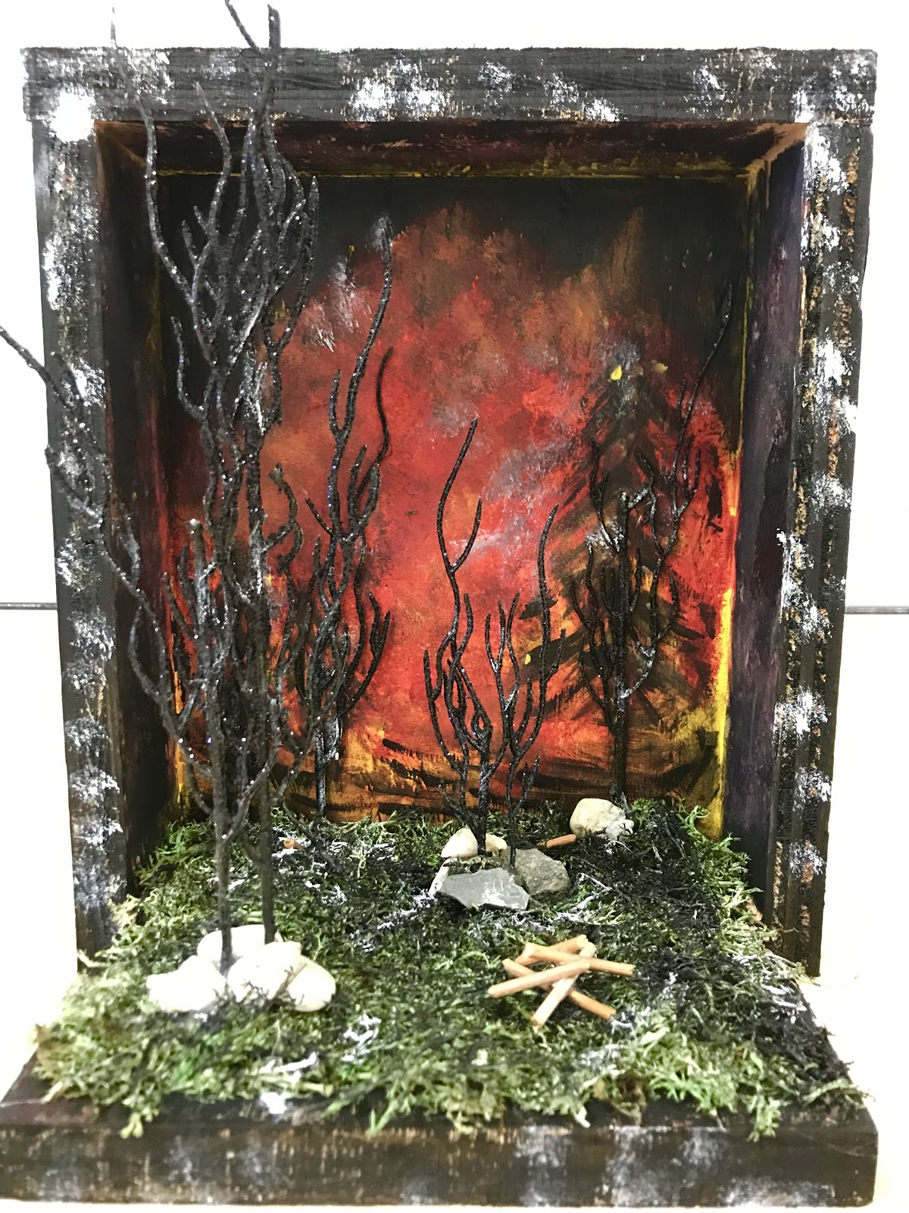
Diorama on Wild Fires
By: Heidi Fernandez

Slide 14


